Slide 1
NURSE CALLING SYSTEM
GROUP MEMBERS:
1)MITHUNRAJ M -22BAI1136
2)KHOUSHAL -22BAI1315
3)EZHILVENDAN -22BCE1050

Slide 2
About the Product
A nurse calling system, often referred to as a nurse call system or nurse call bell system, is a crucial piece of technology used in healthcare facilities such as hospitals, nursing homes, and assisted living centers. This system plays a vital role in ensuring efficient and timely communication between patients and healthcare staff, contributing significantly to patient care and safety.
At its core, a nurse calling system consists of various components, including call buttons or call cords placed within patient rooms or common areas, a central control station or console located at the nursing station, and a network of communication devices and infrastructure.
The primary purpose of this system is to enable patients or residents to summon assistance from nurses or caregivers when needed, whether it's for medical assistance, addressing comfort needs, or responding to emergencies.

Slide 3
About the product
The functionality of nurse calling systems has evolved significantly over the years. Traditionally, these systems relied on simple call buttons and lights to signal requests for help. However, with advancements in technology, modern nurse calling systems are now often wireless and feature-rich.
They can incorporate features such as two-way audio communication, integration with electronic health records (EHR) systems, location tracking, and real-time alerts to provide a comprehensive solution for patient care

Slide 4
PROBLEM STATEMENT
To implement a nurse calling system in order to improve the healthcare system and address patients’ grievances immediately.
SOLUTION AND SUPPORT
We will be designing a simple and efficient nurse calling system using ESP8266 nodemcu.
In order to increase effortless and contactless usage for the various patients , a button sensor is being used which increases convenient usage and unintentional alerts.
In addition to this the device will send a message to the nurse and creates awareness about the patient’s needs.

Slide 5
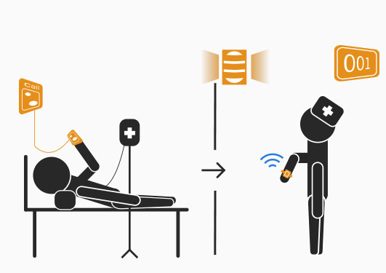
IMPLEMENTATION:
For simplicity we will be demonstrating the system with two patients and one nurse.
This system will ensure direct communication between patient and nurse in a wireless fashion.
Each patient will be addressed with a unique id to differentiate between different patients.

Slide 6
Working of the system:
The patient setup will be a simple button connected to an ESP8266 microcontroller.
When the button is pressed the microcontroller detects this and sends the signal via the default wifi module present in ESP8266 microcontroller.
This signal is received by the nodeRED software which sends the message to the nurse’s mobile phone.
The signal from each of the microcontroller is different by which we can identify which patient is calling.

Slide 7
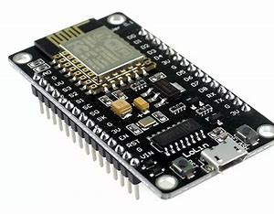
COMPONENTS REQUIRED:
ESP8266 nodemcu microcontroller.
BREADBOARD
button
Node red software

Slide 8
Budget:
ESP8266 (2 NOS)-450
BREADBOARD- 120
buttons- 50
TOTAL COST OF PROJECT=620 /- APPROX

Slide 9
SOCIAL NEED
Nurse calling systems address key social needs in healthcare by:
Patient Confidence: Patients feel secure knowing help is just a button press away.
Timely Assistance: Immediate responses ensure patient needs are met promptly.
Clear Communication: Patients can easily communicate with healthcare providers.
Dignity and Privacy: Calls allow discreet requests, preserving patient dignity.
Reduced Alarm Fatigue: Integrations streamline notifications for staff.

Slide 10
SOCIAL NEED
Family Peace of Mind: Families know their loved ones can seek help quickly.
Efficient Workflow: Staff can manage tasks more effectively.
Patient-Centered Care: Allows tailored care based on individual needs.
Quality Improvement: Data collection helps enhance care quality and satisfaction.
Nurse calling systems foster a patient-centered and responsive healthcare environment.

Slide 11
Market size
The global nurse call systems market size was valued at USD 1.7 billion in 2022 and is expected to expand at a compound annual growth rate (CAGR) of 12.11% from 2023 to 2030. The growing need for a diverse and integrated platform that increases the preference for mobility aids are driving the market.

Slide 12
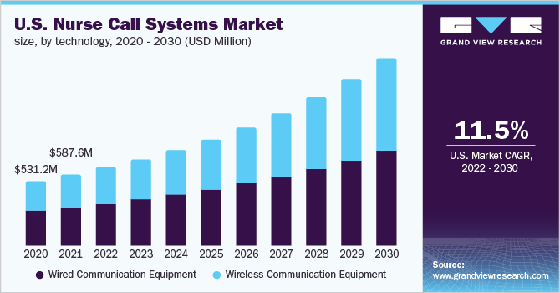
MARKET SIZE

Slide 13
COMPETITORS
The market for wireless nurse calling systems is competitive, with several companies and manufacturers offering solutions designed to meet the needs of healthcare facilities such as hospitals, nursing homes, and assisted living centers. Some of the key competitors in this market are:
Rauland (A division of AMETEK, Inc.):
Rauland is a well-established company that provides communication and nurse call systems for healthcare facilities. They offer a range of wireless nurse call solutions designed to enhance patient care and staff communication.
Hill-Rom Holdings, Inc. :
Hill-Rom is a global medical technology company that offers a variety of healthcare solutions, including nurse call systems. Their products include wireless nurse call systems that can integrate with other healthcare technologies.

Slide 14
competitors
Ascom:
Ascom is a Swiss-based company that specializes in healthcare communication solutions, including wireless nurse call systems. They provide products and services to improve communication and workflow efficiency in healthcare environments.
Jeron Electronic Systems, Inc:
Jeron is known for its nurse call systems, including wireless options. Their solutions focus on enhancing communication and response times in healthcare facilities.
TekTone Sound & Signal Mfg., Inc:
TekTone is a manufacturer of nurse call and emergency communication systems for healthcare facilities. They offer both wired and wireless nurse call solutions.

Slide 15
COMPETITORS
Cornell Communications:
Cornell Communications is a provider of nurse call and emergency communication systems, including wireless nurse call systems. They cater to a range of healthcare settings.
West-Com Nurse Call Systems, Inc :
West-Com specializes in nurse call and communication systems for healthcare facilities. They offer a range of wireless nurse call solutions to improve patient care.
Stanley Healthcare:
Stanley Healthcare provides a variety of healthcare solutions, including nurse call systems. They offer wireless nurse call systems that can integrate with other healthcare technologies for improved efficiency.

Slide 16
PATENTS
1) US9183732B2 - Tektone Sound &Signal Mfg, Inc-Dual Band nurse call system.
2) US8779924B2 - Hill-Rom Services, Inc. –Nurse call system with additional status board.
3)US20060058587A1 Heimbrock Richard H-Wireless control system for a patient support apparatus.
4)US3553383A – Int Standard Electric Corp- Hospital communication system having provision for connecting patient with nearest nurse-occupied station.
5)US5838223A – Hill-Rom, Inc. - Patient/nurse call system

Slide 17
EXISTING PRODUCTS
Existing products in the field of nurse calling systems include brands like Rauland, Jeron, TekTone, and Cornell. These systems are designed to facilitate communication between patients and healthcare providers in medical facilities.The starting price of the system starts from 17000 and goes till 80000 depends on the complexity of the system.

Slide 18
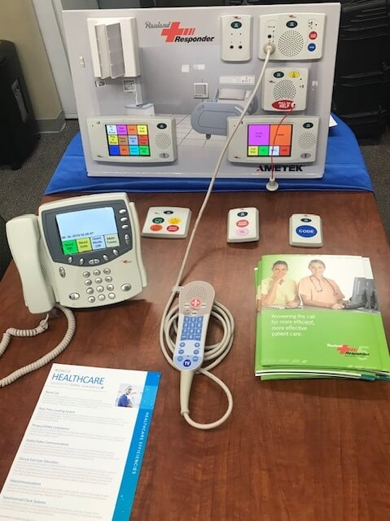
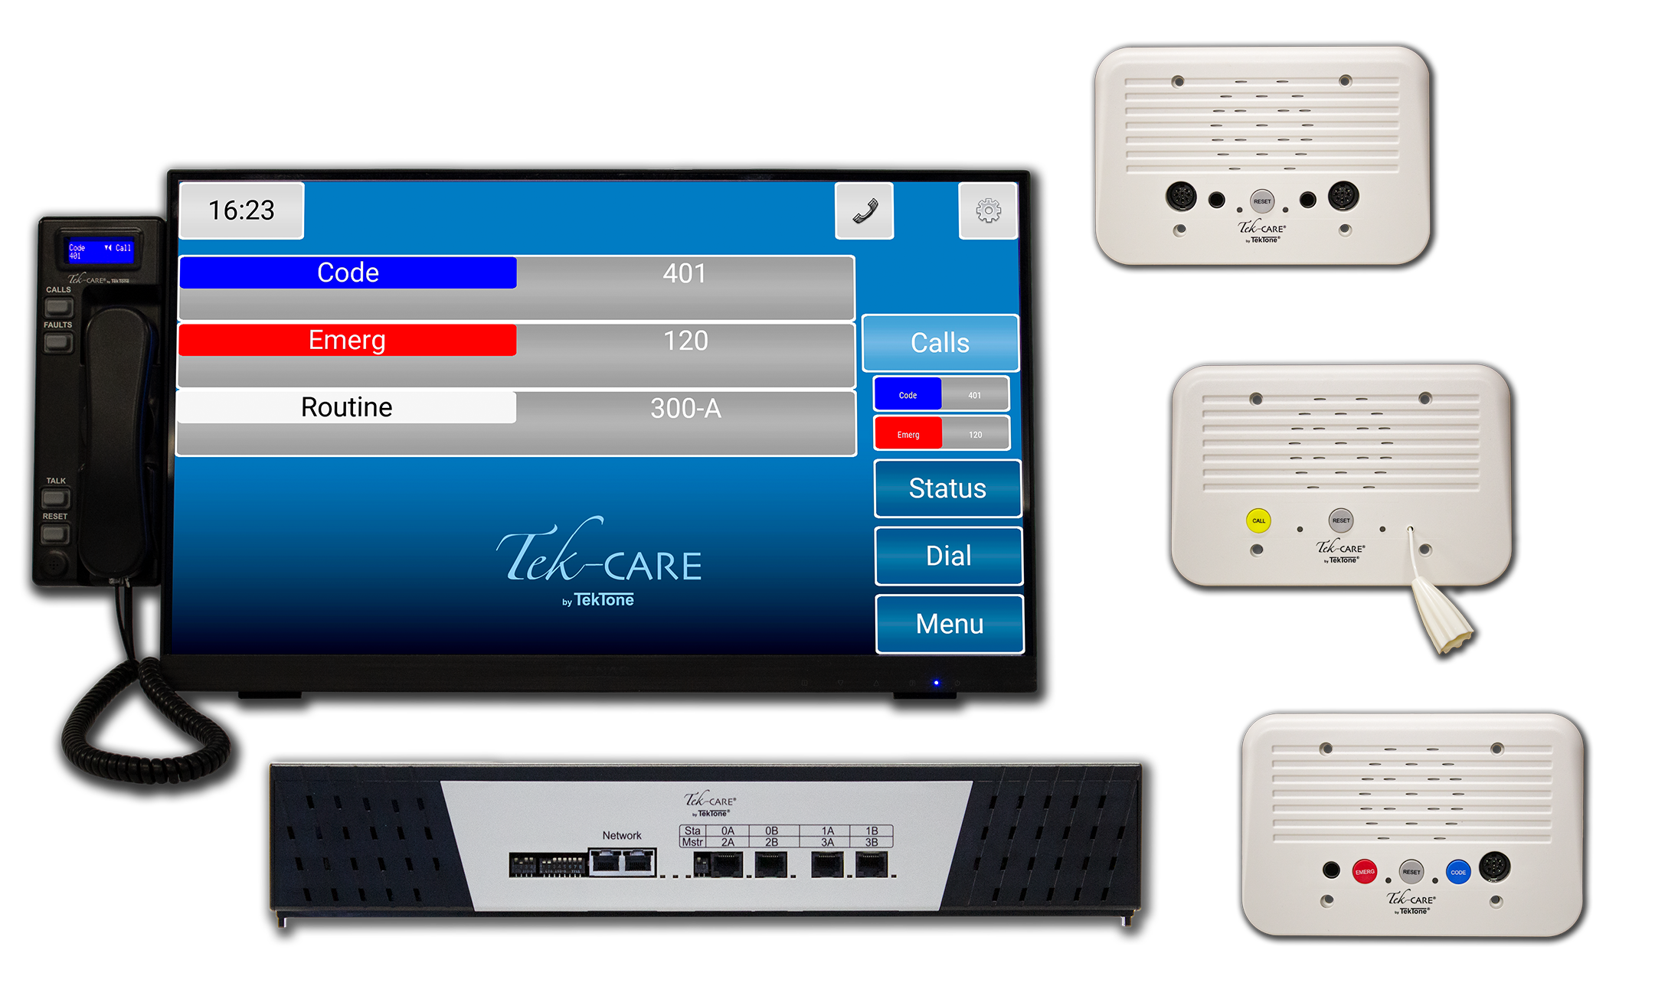
RAULAND
TEKTONE

Slide 19
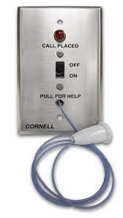
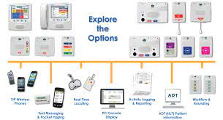
CORNELL
JERON

